Slide 1

ECEN 3593-001 Computer Organization
Lecture #22
10 March 2021

Slide 2


Agenda
Class Announcements
Mid-Term update
Class Project Information
Chapter 1

Slide 3
Class Announcements
Reading Assignment
“Computer Organization and Design, The Hardware / Software Interface, RISC-V edition,” by David Patterson and John Hennessy
ISBN 978-0-12-812275-4
Chapter 1, “Computer Abstractions and Technology”
Sections 1.1 thru 1.11 required
Section 1.12 (optional)
pages 2-54
Homework #3 Grades will be posted by Friday, and correct answers revealed

Slide 4
Class Announcements
Phase 6 is in the deduction period – 4%/day
Phase 7 is posted – Target Date Sunday, March 21 at 10:00 PM
Bonus 1%/day (maximum 7%)
Deduction 4%/day

Slide 5
Mid-Term
Mid-Term will be held in class on Wednesday, March 17
Mid-Term practice exam will be posted by Thursday
“Computer Organization and Design” text book, and RISC-V ISA specifications will be required for reference for figures as well as to create and decode RISC-V machine code
The Mid-Term will be taken through a Canvas quiz
50 minutes
1 attempt
Open Book, but not Open People, and not google

Slide 6
Mid-Term
Mid-Term compensation
4 questions similar to questions in homework #1 thru #3
Quiz bank of 12-18 questions
(estimating 30 minutes)
~50% of Mid-Term
15 multiple choice / matching questions
Quiz bank of 30-45 questions
Definitions / Theory based questions to test comprehension of the course material
(estimating 15 minutes)
~50% of Mid-Term
Suggestion: If you are stuck on a problem, make note of it and move on to complete other questions. Then go back and work on the problems that you passed over the first time
Do not lose the opportunity to complete questions that you know

Slide 7
Debugging Phase 6, 7, 8 … and Beyond
Answer the three questions
Where is the failure (i.e. what instruction is misbehaving)?
What is happening?
What should be happening?
In Phase 6, the failure was always a register written incorrectly
In Phase 7, the failure can also be a branch branching incorrectly

Slide 8
Debugging Phase 6, 7, 8 … and Beyond
Once you know the error, use - -info 7 (for register errors) or - -info 11 (for branch errors)
Step through instructions, looking for what causes the error
Set a breakpoint in EX (for register errors) or ME (for branch errors)
ex_output() and me_output() are very good places
Get to the cycle when the bad instruction is in that stage – look at r_STG_instr
Use hovering to trace the data back
Use the documents in the Debug section of Canvas

Slide 9
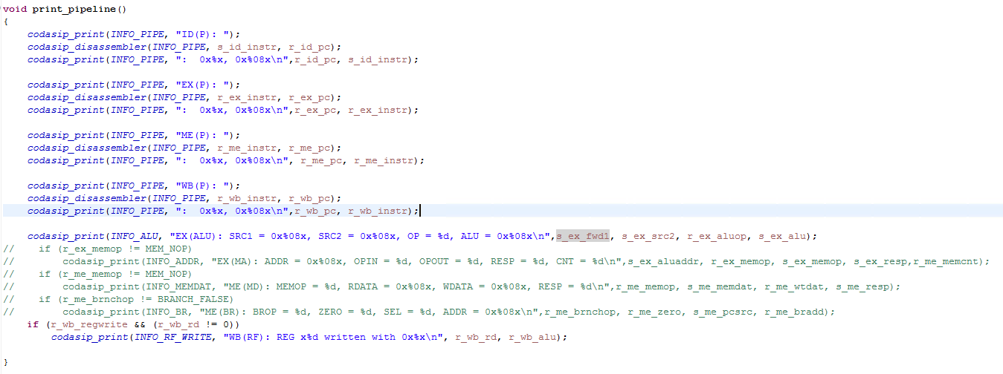
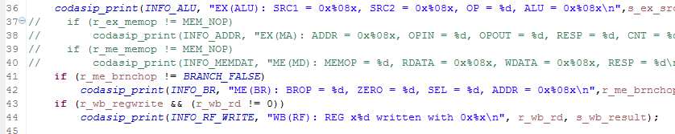
Fixing the - -info Function
Check Section 6.4.1 in the Phase 6 document
Check Section 6.5.1 in the Phase 7 document

Slide 10
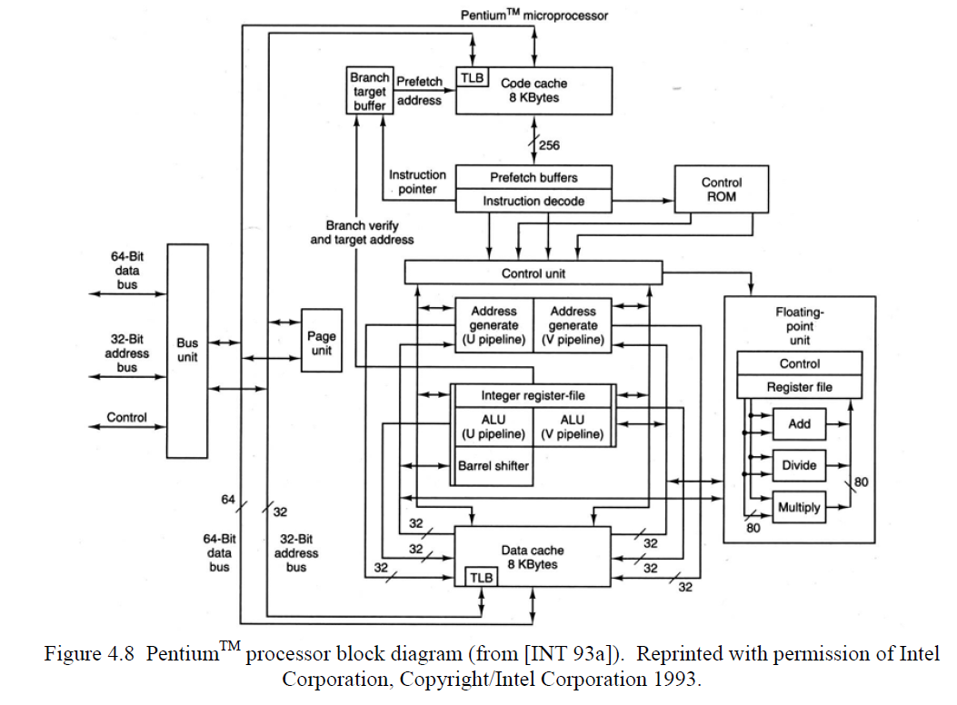
Computer Architecture
CISC (Complex Instruction Set Computers)
Pentium II
Some of the instructions are entirely hardwired and can be executed in one clock cycle (a RISC property)
Other instructions use microinstructions for execution and may require more than one cycle for execution time (a CISC property)
CISC Architecture

Slide 11
Why CISC?
Causes for increased architectural complexity
Support for high-level languages
Computers moved from assembly language to high-level language
Example of Abstraction
Example of high level instructions
For (int j; j < top_of_memory; j++) {};
If (door_is_open == true) {};
Support of these instructions would not be easy in a hardwired machine

Slide 12
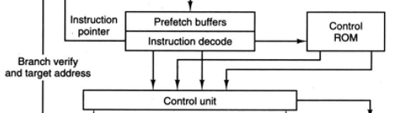
Why CISC?
Causes for increased architectural complexity
Migration of functions from software to hardware
Generally, a single instruction realized in hardware will perform better than one realized by a sequence of simpler instructions by minimizing the number of memory accesses for instructions
To realize an increase in speed of computers, there was a phenomenon of migration from software to firmware and then firmware to hardware
Increasing the overall complexity of the computer

Slide 13
Why CISC?
Causes for increased architectural complexity
Backward compatibility
Marketing strategy to project the new computers are better than existing models
Increases the number of instructions and their power regardless of their actual use
The new instruction set is a superset of the previous generation
Intel Processor architecture evolution (116 instructions initially)
1980 – added 60 floating point instructions to the 8086/87
1989-95 – added 4 instructions to the 80486
1997 – added 57 instructions to the Pentium
1999 – added 70 instructions to the Pentium III
2001 – added 144 instructions
2004 – added 13 instructions
2006 – added 54 instructions
2007 – added 170 instructions
2011 – added 128 instructions
Total 816 instructions
Not Simple
How could the HW optimize them all?
How could a compiler use all of the instructions?

Slide 14
What did RISC take advantage of by removing CISC’s microcode?
Registers
The microcode is a very low-level instruction set that is stored permanently in a computer or peripheral controller and controls the operation of the device
One performance increase was to add registers to remove the performance limiting I/O to memory

Slide 15
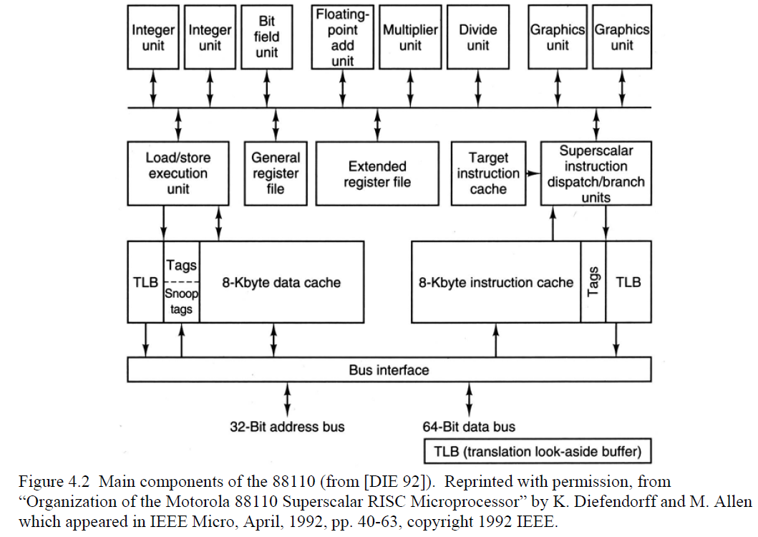
Computer Architecture
RISC (Reduced Instruction Set Computers)
Common characteristics
Limited or simple instruction sets – no micro code
On-chip memories / registers
A compiler to maximize the use of the registers thereby minimizing main memory access
Optimizing the instruction pipeline
RISC Architecture

Slide 16
Why RISC?
Computer designers goals
Minimize execution time
Minimize development cost and sale price
How to minimize execution time?
Simpler designs = shorter delays
Minimize clock cycles per instruction
Simpler design equates to smaller and simpler circuits
Enabling VLSI
May degrade instruction efficiency
$\frac{Seconds}{Clock Cycle} X \frac{Clock Cycles}{Instruction}$ $X \frac{Instructions}{Function}$= $\frac{Seconds}{Function}$
$$\frac{Seconds}{Clock Cycle}$$
$$\frac{Clock Cycles}{Instruction}$$
$$\frac{Instructions}{Function}$$

Slide 17
Why RISC?
VLSI effects
Realize the entire processor on a single chip
Control unit area of a chip
CISC 40-60%
RISC ~10%
What can you do with the extra 30-50% die area?
Address performance limiting bottlenecks
Reduce memory accesses by adding register files and caches
Moore’s Law
Minimizes $\frac{Clock Cycles}{Instruction}$

Slide 18
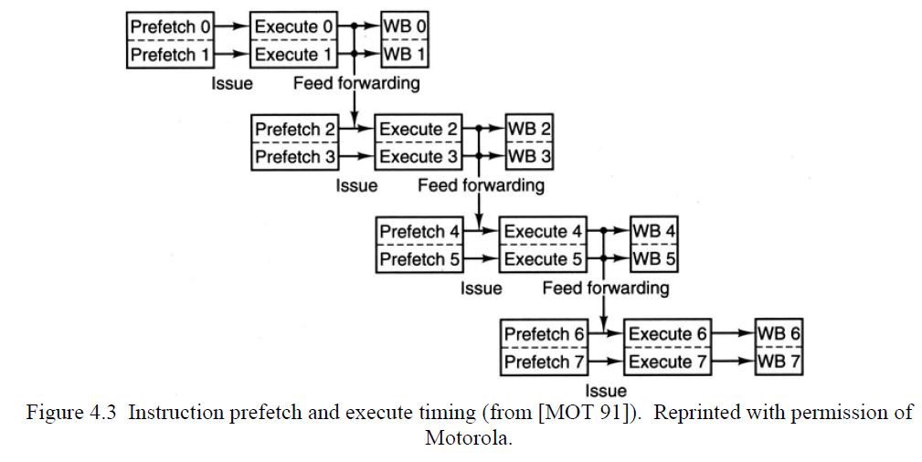
Why RISC?
Pipelining
CISC control units are microcode based
With varying microcode operations per instructions
RISC control unit is hardwired
Each instruction (within a type) is similar
Regularity enables implementation via pipelining
Minimizes $\frac{Seconds}{Clock Cycle}$

Slide 19
Why RISC?
Regularity = Simpler design
Shorter design cycles
Lower design costs
More quickly to take advantage of newer processor nodes
NO microcode to debug = Simpler verification
Less chance of errors
More reliable

Slide 20
RISC architecture general characteristics
Most instructions access operands from registers
Execution of most instructions requires a single processor clock cycle
Instructions have a fixed format and do not cross word boundaries
The control unit is hardwired
Low number of instruction formats
The CPU has a large register file
Complexity is in the compiler
Relatively few instructions
Judicious support of High-Level Language operations
Makes use of Instruction pipeline, multiple prefetch and branch prediction techniques

Slide 21
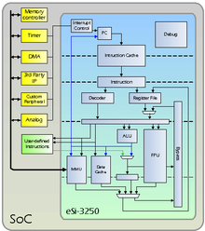
Definitions
Load-Store Machine or Architecture
Load/Store operations are used to place variables from memory into the registers
Most instructions access operands from registers
Example psuedocode:
Load $s1, Number_of_Seconds_Per_Minute
Load $s2, Number_of_Minutes_Taken_To_Complete
Multiply $s0, $s1, $s2
Store $s0, Number_of_Seconds_Taken_To_Complete
RISC architectures are load-store machines

Slide 22
RISC design versus CISC design
Three key factors that determine how much time a processor takes to complete a program:
The number of instructions in the program
The average number of clock cycles required to execute an instruction
The clock cycle time
CISC focuses on reducing the number of program instructions
RISC focuses on reducing the average number of clock cycles required to execute an instruction and cycle time

Slide 23
RISC design versus CISC design
Because of the simple architecture of RISC, its performance is directly related to the compiler efficiency
The performance of the RISC machine is based on its reliance on a high utilization of its register file, so compiler optimization of the registers is critical
Example:
for (int i=0; i < Number_Of_Temp_Readings; i++) {
Summation += ADC0_DMArambuffer[i];
}
In 2015, the Silicon Labs’ GCC compiler took 6 instructions to complete the loop
In 2016, the same loop on the same microcontroller now takes 4 instructions

Slide 24
Next Lecture
Major discussion of Phase 7

